Slide 1
Network Simulation With Max plus Algebra
Waylon Jepsen

Slide 2
MAX Plus Algebra
Waylon Jepsen

Slide 3
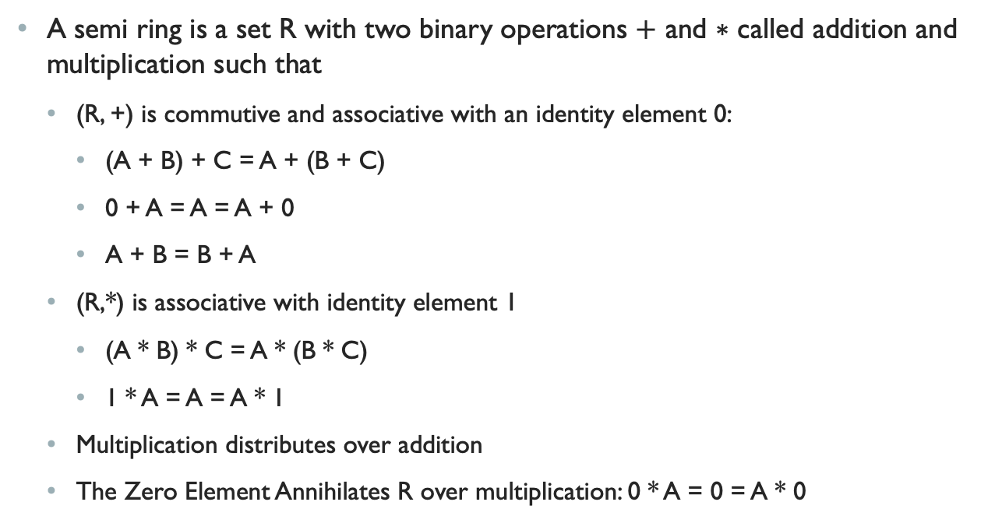
Max Plus Algebra is a Semi-ring
A semi ring is a set R with two binary operations $+$ and $∗$ called addition and multiplication such that
(R, +) is commutive and associative with an identity element 0:
(A + B) + C = A + (B + C)
0 + A = A = A + 0
A + B = B + A
(R,*) is associative with identity element 1
(A * B) * C = A * (B * C)
1 * A = A = A * 1
Multiplication distributes over addition
The Zero Element Annihilates R over multiplication: 0 * A = 0 = A * 0

Slide 4
Ring vs Semi-Ring
A Semi ring omits the requirement of an additive inverse
In a ring an additive inverse implies a multiplicative zero which is why it needs to be explicitly specified here.
(Max, +) and (Min, +) are classified as tropical semi-rings (where Min/Max and addition is used to replace the traditional multiplication and addition.
These tropical semi-rings have applications in evaluating the performance of discrete event systems.
Real numbers are arrival times
Max can be used to refer to waiting for a completion of all prior events
Min can be used to select the best least costly choice
+ is an accumulation along a path

Slide 5
Examples in Computer Science
The Floyd-Warshall Algorithm is an algorithm for finding shortest paths in a directed weighted graph.
Described by the (min, +) tropical semi-ring.
+ accumulates the weight along a path
min chooses the shortest one.
The Viterbi algorithm for dynamic programing applies a similar representation

Slide 6
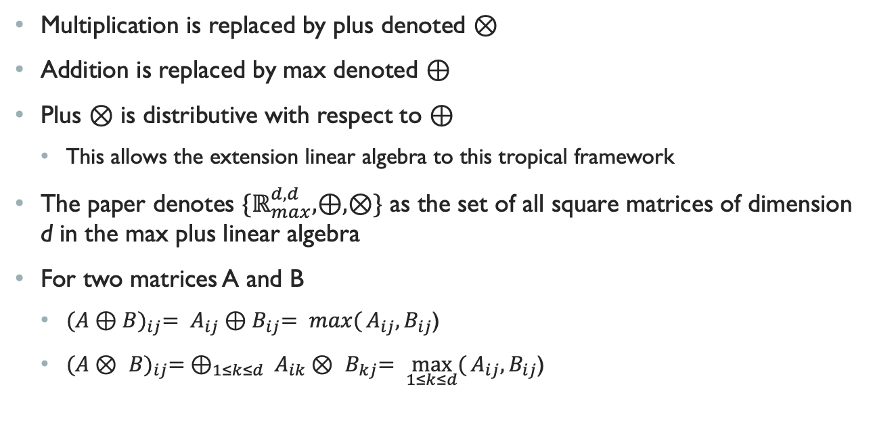
Max plus
Multiplication is replaced by plus denoted $⊗$
Addition is replaced by max denoted $⊕$
Plus $⊗$ is distributive with respect to $⊕$
This allows the extension linear algebra to this tropical framework
The paper denotes ${\{ℝ}_{max}^{d,d},⊕,⊗\}$ as the set of all square matrices of dimension d in the max plus linear algebra
For two matrices A and B
${(A⊕B)}_{ij}= A_{ij}{⊕B}_{ij}= \max{(}A_{ij}{,B}_{ij}$)
${(A⊗ B)}_{ij}= ⊕_{1≤k≤d} A_{ik}{⊗ B}_{kj}= \max_{1≤k≤d}{(}A_{ij}{,B}_{ij}$)

Slide 7
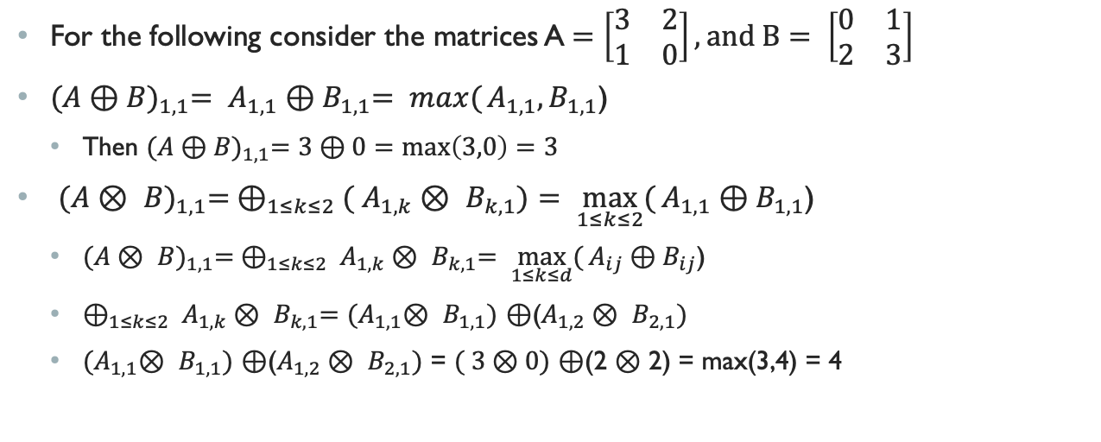
Examples
For the following consider the matrices A$=\left[\begin{matrix}3 & 2 \\ 1 & 0\end{matrix}\right], and B= \left[\begin{matrix}0 & 1 \\ 2 & 3\end{matrix}\right]$
${(A⊕B)}_{1,1}= A_{1,1}{⊕B}_{1,1}= \max{(}A_{1,1}{,B}_{1,1}$)
Then ${(A⊕B)}_{1,1}=3⊕0=max\left(3,0\right)=3$
${(A⊗ B)}_{1,1}= ⊕_{1≤k≤2}( A_{1,k}{⊗ B}_{k,1})= \max_{1≤k≤2}{(}A_{1,1}{⊕B}_{1,1}$)
${(A⊗ B)}_{1,1}= ⊕_{1≤k≤2} A_{1,k}{⊗ B}_{k,1}= \max_{1≤k≤d}{(}A_{ij}{⊕B}_{ij}$)
$⊕_{1≤k≤2} A_{1,k}{⊗ B}_{k,1}=$ ${(A}_{1,1}{⊗ B}_{1,1})$ $⊕$($A_{1,2}{⊗ B}_{2,1})$
${(A}_{1,1}{⊗ B}_{1,1})$ $⊕$($A_{1,2}{⊗ B}_{2,1})$ = $( 3⊗0)$ $⊕$(2 $⊗$ 2) = max(3,4) = 4

Slide 8
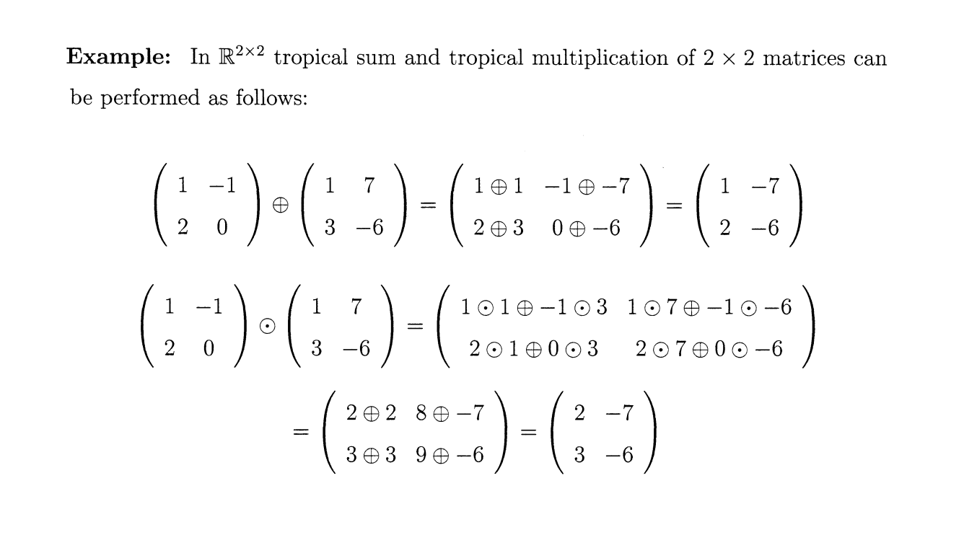
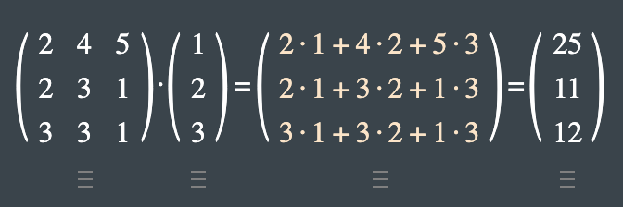
Examples
In Regular Algebra

Slide 9
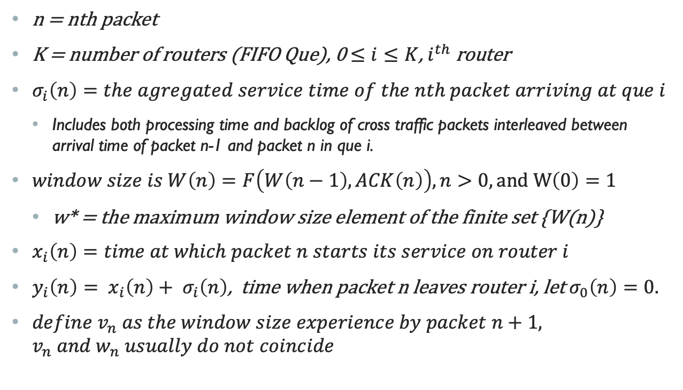
Definitions
n = nth packet
K = number of routers (FIFO Que), 0 $≤i≤K$, $i^{th}$ router
$σ_{i}\left(n\right)=the agregated service time of the nth packet arriving at que i$
Includes both processing time and backlog of cross traffic packets interleaved between arrival time of packet n-1 and packet n in que i.
$window size is W\left(n\right)=F\left(W\left(n−1\right),ACK\left(n\right)\right), n>0, and W\left(0\right)=1$
w* = the maximum window size element of the finite set {W(n)}
$x_{i}\left(n\right)=time at which packet n starts its service on router i$
$y_{i}\left(n\right)= x_{i}\left(n\right)+ σ_{i}\left(n\right)$, time when packet n leaves router i, let $σ_{0}\left(n\right)=0.$
${define v}_{n} as the window size experience by packet n+1, v_{n} and w_{n} usually do not coincide$

Slide 10
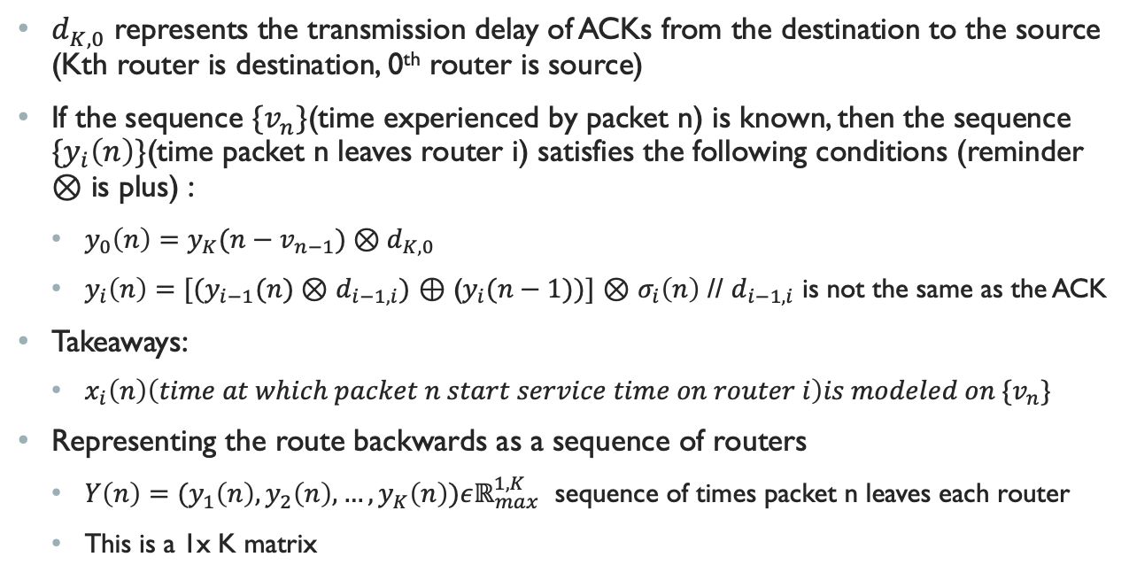
Continued
$d_{K,0}$ represents the transmission delay of ACKs from the destination to the source (Kth router is destination, 0th router is source)
If the sequence ${\{v}_{n}\}$(time experienced by packet n) is known, then the sequence ${\{y}_{i}\left(n\right)\}$(time packet n leaves router i) satisfies the following conditions (reminder $⊗$ is plus) :
$y_{0}\left(n\right)=y_{K}(n−v_{n−1})⊗d_{K,0}$
$y_{i}\left(n\right)=[(y_{i−1}(n)⊗$ $d_{i−1,i})$ $⊕$ ($y_{i}(n−1))]$ $⊗$ $σ_{i}\left(n\right)$ // $d_{i−1,i}$ is not the same as the ACK
Takeaways:
$x_{i}\left(n\right)\left(time at which packet n start service time on router i\right)is modeled on {\{v}_{n}\}$
Representing the route backwards as a sequence of routers
$Y\left(n\right)=(y_{1}\left(n\right),y_{2}\left(n\right),…,y_{K}\left(n\right))εℝ_{max}^{1,K}$ sequence of times packet n leaves each router
This is a 1x K matrix

Slide 11
Making Max Plus Matrices
Reminder: The route of the ACK is
$Y\left(n\right)=(y_{1}\left(n\right),y_{2}\left(n\right),…,y_{K}\left(n\right))εℝ_{max}^{1,K}$ << vector of times packet n leaves routers
Z$\left(n\right)={(Y\left(n\right),Y \left(n−1\right),…,Y\left(n−w^{∗}+1\right))}^{t}εℝ_{max}^{K.w^{∗},1}$ < this is referred to as the dater vectors << vector of vectors representing all packet paths and times
$w^{∗}$ the maximum window size element of the finite set {W(n)}
Lemma 1[Max plus representation] if the system is initially empty and the sequence ${{\{v}_{n}\}}_{nεℕ}$, then the dater vectors Z$\left(n\right)$ satisfy
Z$\left(n\right)$ = $A_{v_{n−1}}(n)$ $⊗$ Z$\left(n−1\right), n≥1, where \text{Z}\left(0\right)={\{0,…,0\}}^{t}$,
$A_{1}\left(n\right)=(M(n)$ $⊕$ $M^{′}\left(n\right)\left|ε\right|…|ε)$ $⊕$ D
$A_{2}\left(n\right)=(M(n)$ |$M^{′}\left(n\right)\left|ε\right|…|ε)$ $⊕$ D
$A_{w^{∗}}\left(n\right)=(M(n)$ $\left|ε\right|…|ε|M^{′}\left(n\right))$ $⊕$ D

Slide 12
M and M’
${(M\left(n\right))}_{i,j} = \left\{\begin{aligned}\sum_{k=j}^{i}{σ_{k}(n)}+\sum_{k=j}^{i−1}{d_{k,k−1}}, if i ≥j \\ −∞, if i<j\end{aligned}\right.$
${(M′\left(n\right))}_{i,j} = \left\{\begin{aligned}\sum_{k=1}^{i}{(d_{k−1,k}}+σ_{k}(n))+d_{K,0}, if j=K \\ −∞, if j<K\end{aligned}\right.$
D is the square matrix of dimension Kw* with all its entries equal to $−∞$ except $D_{K+1,i}$, with $i=1 ,…, K($w* - 1), which are all equal to 0
$ε$ is the K x K matrix with all entries equal to $−∞$

Slide 13
Dimensionalities
Z$\left(n\right)$ = $A_{v_{n−1}}(n)$ $⊗$ Z$\left(n−1\right), n≥1, where \text{Z}\left(0\right)={\{0,…,0\}}^{t}$,
$A_{1}\left(n\right)=(M(n)$ $⊕$ $M^{′}\left(n\right)\left|ε\right|…|ε)$ $⊕$ D
$A_{2}\left(n\right)=(M(n)$ |$M^{′}\left(n\right)\left|ε\right|…|ε)$ $⊕$ D
$A_{w^{∗}}\left(n\right)=(M(n)$ $\left|ε\right|…|ε|M^{′}\left(n\right))$ $⊕$ D
M(n) is of dimension KxK
M’(n) is of dimension KxK
The concatenation that is maxed with D is dimension K.w* x K.w*
D is a square matrix of dimension K.w*
Z(n-1) is a of dimension K.w* x 1
Operations will produce a column of dimension K.w* x 1

Slide 14
Discrete event simulators
Each event happens at a particular time
Events mark a change in state of the system
Used to model real world processes, like customer experiences, NoC, etc

Slide 15
Simpy
Discrete event simulator library
Goto networking components
Mac plus algebra class

